Slide 1
I2C Communication for MPU6050 Data Acquisition

Slide 2
Starting Notes :
Everything that I say will be from the point of view of understanding I2C protocol for communication between an AVR (specifically ATTiny2313) microcontroller and the MPU6050 Inertial Measurement Unit
I will be explaining both codes & concepts simultaneously in a way that both compliment each other’s understanding

Slide 3
Mind Map :
I2C Protocol
Basics
Circuit
Bus Connection
I/O Port Structure of AVR microcontrollers
I2C Specifications
Signal Specifications
Data Packet Specifications
Device Specifications
MPU6050
Device Specifications
Register Map
Notes:
I will spend much more time in explaining I2C and relevant codes, because once that is understood, interfacing with MPU6050 is very easy

Slide 4
I2C COMMUNICATION
PROTOCOL

Slide 5
Communication Protocol :
A communication Protocol is a set of rules agreed upon by two or more devices for the purpose of information exchange
Notes:
In the case of I2C,
the protocol is a set of rules about the values and precedence of signals on the bus that convey meaningful information

Slide 6
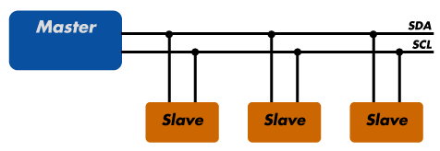
Basics :
Inter Integrated Circuit Bus
Developed by Philips (now by NXP semiconductors)
official documentation at
http://www.nxp.com/documents/user_manual/UM10204.pdf
Basic Topology :
Serial Data
Serial Clock
Notes:
the official documentation is very detailed and informative, read the Part 3 of the documentation to know everything you will need to know about I2C
Serial Data and Serial Clock + plus a GND line

Slide 7
Each Device is recognised by a Unique ID
A Device may be a :
A transmitter only
A receiver only
A transceiver
Three flavours :
Standard mode : 400 Kbits/s
Fast mode : 1 Mbits/s
High speed mode : 3.4 Mbits/s
More that one master is possible
I2C Device Address
Should be supported
by both Master and
Slave Devices
Notes:
standard mode speed is important because your microcontrollers (even the ATmega’s) can go faster than this speed, and if the slave device does not support speeds faster than 400Kbits/sec, there is going to be a communication problem.
More than one master possible :
bus arbitration should be used to avoid clashes in communication when both master’s try to communicate on the bus.

Slide 8
Terminology :
Master : A device which initiates a transfer, generates clock signals, and terminates a transfer
Slave : A device Addressed by the Master
Notes:
It is very important that a device which initiates a transfer has to terminate it as well

Slide 9
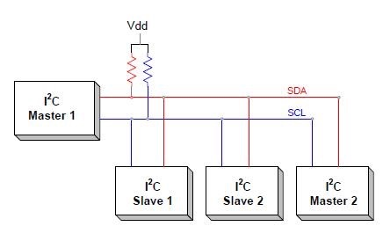
I2C Bus Circuit :
That’s why these
pullup resistors
are required
When the bus is free (not being used for data transfer), both lines should be high
Notes:
Next —> To understand how these lines are controlled at the hardware and the software level, we need to understand the I/O port structure of ATmega microcontrollers

Slide 10
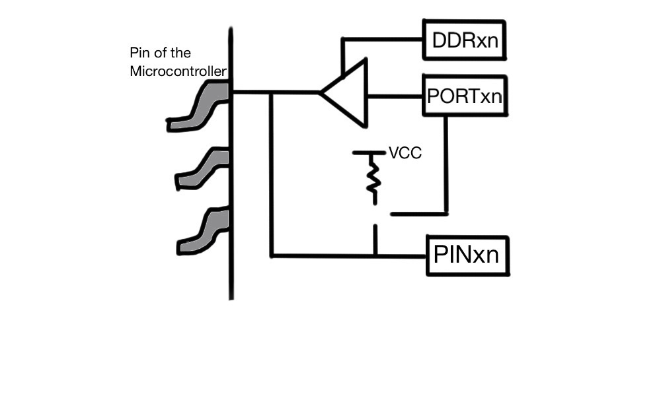
ATmega 328 I/O port structure :
Each microcontroller consists of a number of I/O ports
There are three registers associated with each port :
Data Direction Register (DDRx)
Port Register (PORTx)
Pin Register (PINx)
Notes:
When I say “x”, it is the port name
for example : DDRA for portA, …
Each register is 8 bits long, one bit for each pin of the port.
When I say “n”, it is the bit number of the pin in the port :
for example : DDRA0 is the 0th pin of portA
Next —> Lets see what the functions of these registers are

Slide 11
DDRxn bit controls whether the pin is configured as an input pin or an output pin
PINxn bit stores the “Logic Value” as seen on that pin of the microcontroller
PORTxn bit controls the output of the pin when the pin is configured as an output pin, or else it controls the activation of the pullup register when the pin is configured as an input pin.
Notes:
So, let me explain how this works :
when DDRxn = 1, the buffer is activated, and the value of the PORTxn bit is seen as the pin of the microcontroller.
when DDRxn = 0, the buffer is tristated, and the Logic value at the pin is seen on the PINxn bit.
when the buffer is tristated, the PORTxn bit controls the pullup register :
when PORTxn is 1, pullup register is activated
when PORTxn is 0, pullup register is deactivated

Slide 12
Code :
First, some basics :
HOW DO YOU SET, CLEAR OR OR READ A SINGLE BIT FROM A BYTE ?

Slide 13
Code :
First, some basics :
HOW DO YOU SET, CLEAR OR OR READ A SINGLE BIT FROM A BYTE ?
uint8_t a = 0b11010010;
a |= (0x01 << 2); //set the second bit of “a”
a &= ~(0x01 << 1); // clear the first bit of “a”
(a & (0x01 << 3))>>3; // gives 3rd bit of a
Notes:
next —> Just to quickly explain this

Slide 14
11010010
00000100
—————
11010110
a |= (0x01 << 2)
11010010
11111101
—————
11010110
a &= ~(0x01 << 1)
11010010
00001000
—————
00000000
(a & (0x01 << 3))>>3
Notes:
next —> using these three concepts, I can :
configure a port as input or output
change the output of a port to high or low
activate or deactivate a pullup register
read input value from a pin

Slide 15
#include <avr/io.h>
DDRA |= (0x01 << 3) // pin3 of portA configured as o/p
DDRA &= ~(0x01 << 3) //pin3 of portA configured as i/p
DDRA |= (0x01<<3)
PORTA |= (0x01<<3) //output Logic 1 on pin3 of portA
PORTA &= ~(0x01<<3)//output Logic 0 on pin3 of portA
DDRA &= ~(0x01<<3)
PORTX |= (0X01<<3) //activate pullup register on pin3 of
//portA
PORTX &= ~(0X01<<3)//deactivate pullup register on pin3
//of portA
Notes:
avr/io.h includes all the definitions for the Port Addresses for the particular AVR microcontroller
next —> So, the actual I2C circuit in our case will look like this

Slide 16
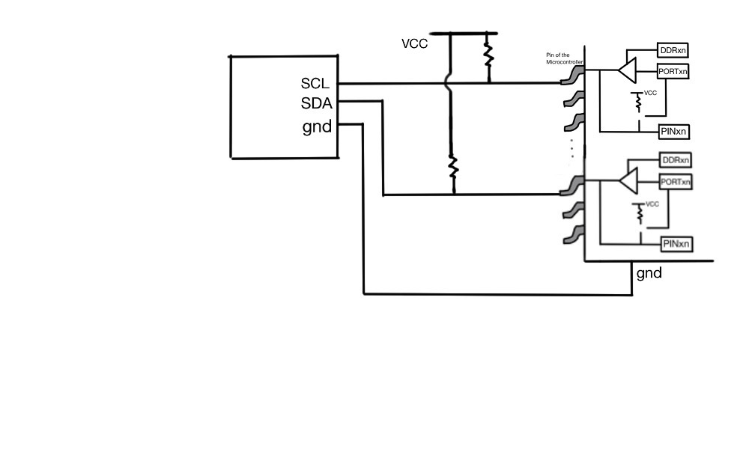
Notes:
next —> now, having discussed the I2C basics and the circuit, lets move on to the I2C specifications

Slide 17
I2C Specifications :
Can be abstracted into three layers of specifications :
Signal specifications
Data Packet specifications
Device specifications
Notes:
signal specifications -> how the signal values should change in order to represent meaningful data
data packet specifications -> In what order must the signals change in order to represent meaningful data
device specifications -> what data does the device expect
next —> so, lets start with signal specifications

Slide 18
Signal Specifications :
Data on the SDA line must be stable during the high period of the clock, th state of data can change only when the SCL line is LOW.

Slide 19
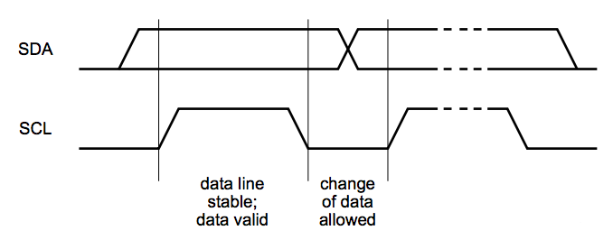
Signal Specifications :
Data on the SDA line must be stable during the high period of the clock, th state of data can change only when the SCL line is LOW.

Slide 20
Signal Specifications :
When Data on the SDA line changes when SCL is HIGH, a special condition is said to have occurred
START condition
STOP condition

Slide 21
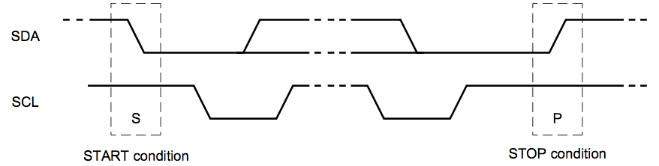
Signal Specifications :
When Data on the SDA line changes during the high period of clock, a special condition is said to have occurred
START condition
STOP condition
(SDA high to low
when SCL high)
(SDA low to high
when SCL high)

Slide 22
Signal Specifications :
After transmission of each byte, the receiver needs to acknowledge the transmitter that the byte has been correctly read.
For this, the transmitter releases the control of the SDA line for one SCL pulse (in our case, configuring the pin as an input pin), and the receiver pulls SDA low for that SCL pulse

Slide 23
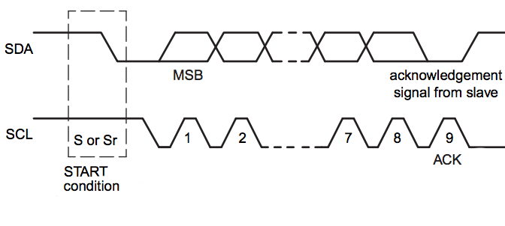
Signal Specifications :
After transmission of each byte, the receiver needs to acknowledge the transmitter that the byte has been correctly read.
For this, the transmitter releases the control of the SDA line for one SCL pulse (in our case, configuring the pin as an input pin), and the receiver pulls SDA low for that SCL pulse

Slide 24
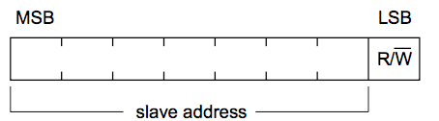
Data Packet Specifications :
Every transmission starts with a START bit
The first byte on every transmission contains the 7-bit slave address and the R/W bit
R/W bit - 0 indicates that the master wishes to write data
R/W bit - 1 indicates that the master wishes to read data

Slide 25
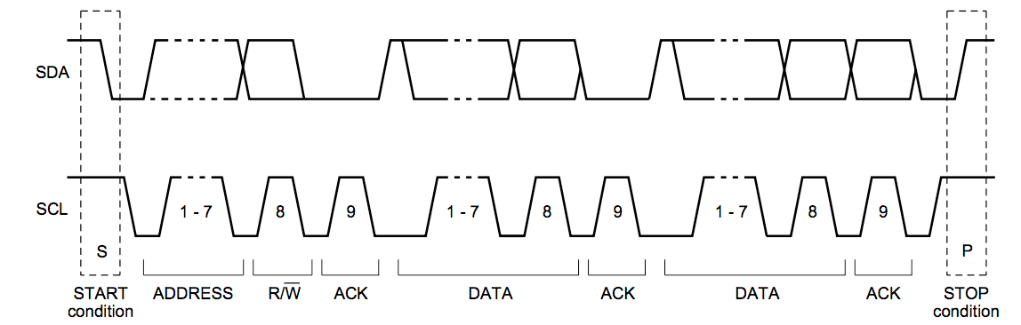
Data Packet Specifications :
Every byte is followed by an Acknowledgement bit
During the “write operation”, the Master controls the SDA line, whereas during the “read operation”, the Slave controls the SDA line
Every transmission starts with a STOP bit

Slide 26
Data Packet Specifications :
A complete data transfer

Slide 27
Data Packet Specifications :
Master Writes one byte of data to the Slave :
START condition
7-bit Slave Address
R/W bit - 0
Acknowledge by Slave
8 bit data on SDA by master
Acknowledge by Slave
STOP condition

Slide 28
Data Packet Specifications :
Master Writes two bytes of data to the Slave :
START condition
7-bit Slave Address
R/W bit - 0
Acknowledge by Slave
8 bit data on SDA by master
Acknowledge by Slave
8 bit data on SDA by master
Acknowledge by Slave
STOP condition

Slide 29
Data Packet Specifications :
Master reads one byte of data from the Slave :
START condition
7-bit Slave Address
R/W bit - 0
Acknowledge by Slave
8 bit data on SDA by Slave
Acknowledge by master
STOP condition

Slide 30
Data Packet Specifications :
Master reads two bytes of data from the Slave :
START condition
7-bit Slave Address
R/W bit - 0
Acknowledge by Slave
8 bit data on SDA by Slave
Acknowledge by master
8 bit data on SDA by Slave
Acknowledge by master
STOP condition

Slide 31
Device Specifications :
In what format does the device expect data in order to communicate the information
Varies from device to device
Notes:
eg: the register address, how many bytes to read
We will look at I2C device specifications for MPU6050
next —> lets see how these things translate to code

Slide 32
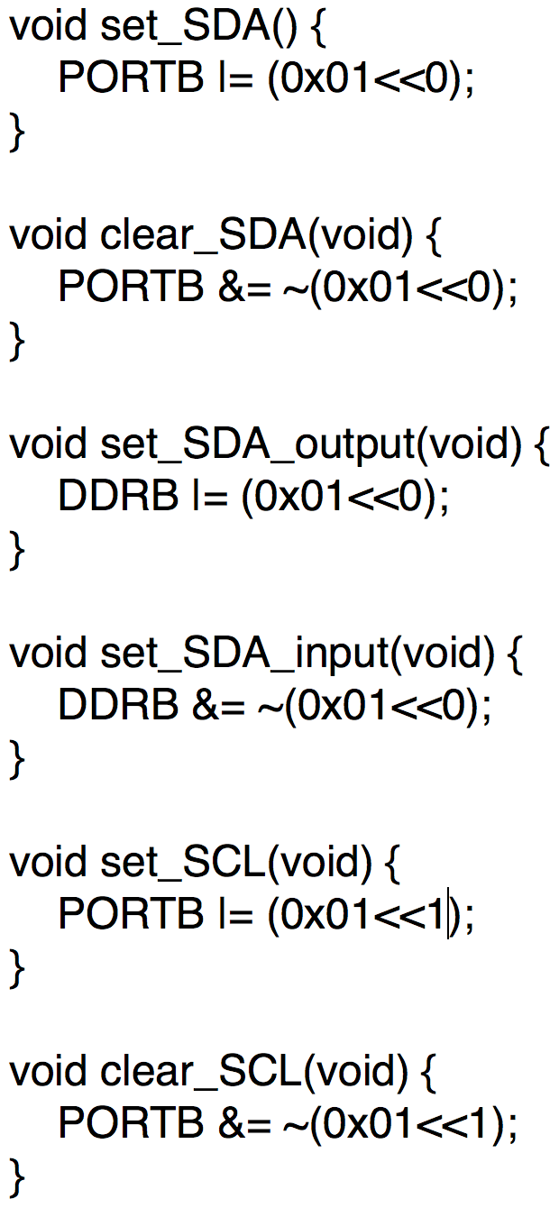
Code :
assuming:
pin0 of portB is SDA
pin1 of portB is SCL
Notes:
firstly, I write down these very simple functions that will make my code much more readable
next —> now using these functions, we can write down more complicated and interesting functions

Slide 33
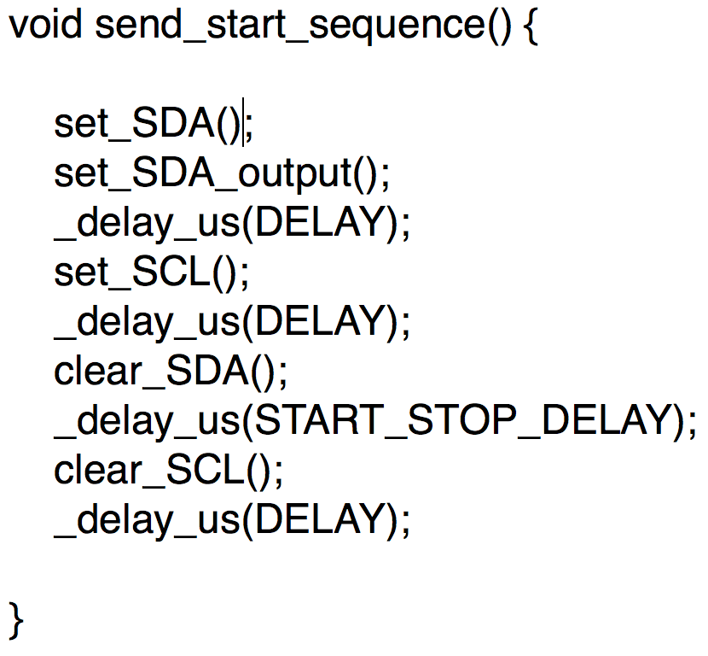
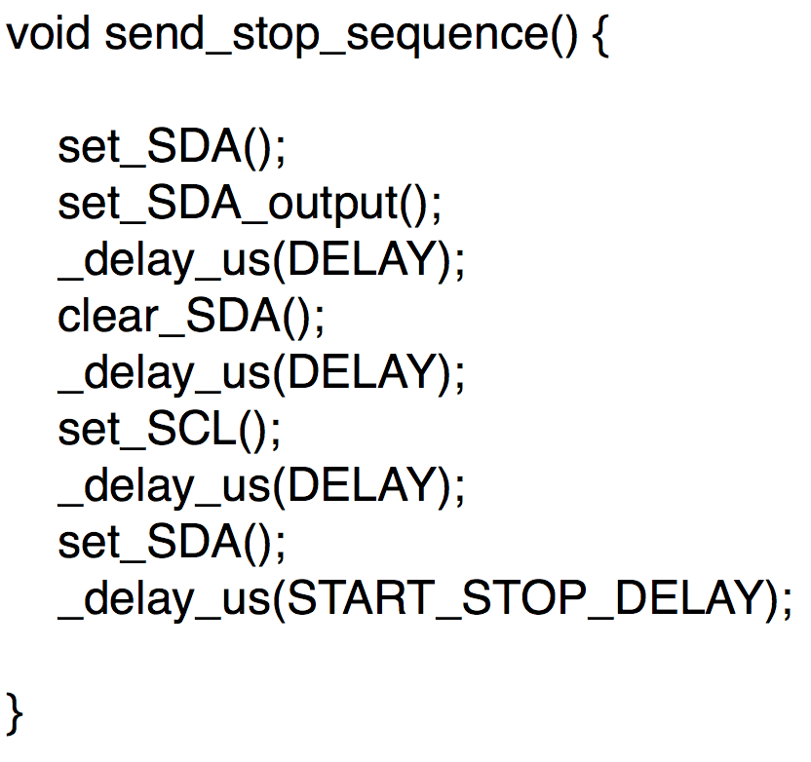
Code :
Notes:
All these functions are perfectly obvious from the signal specifications and data packet specifications

Slide 34
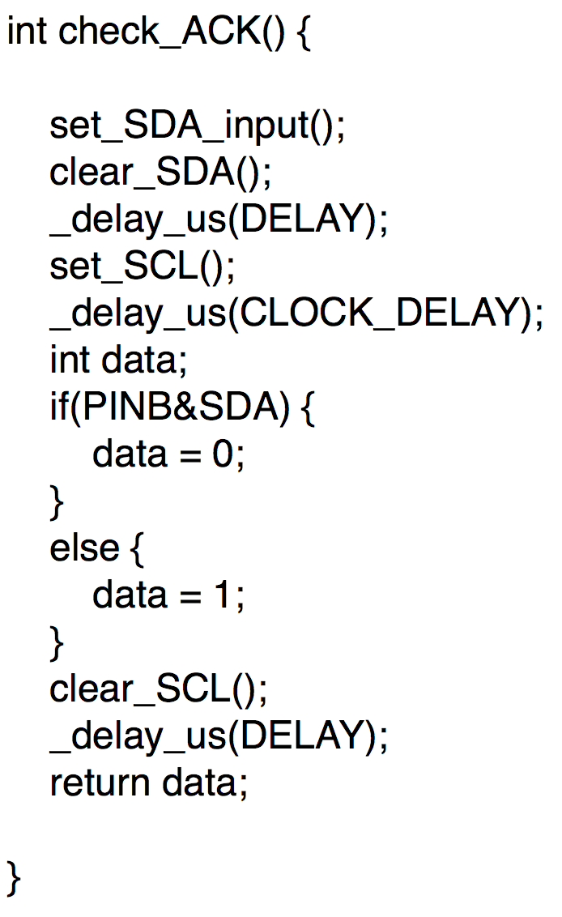
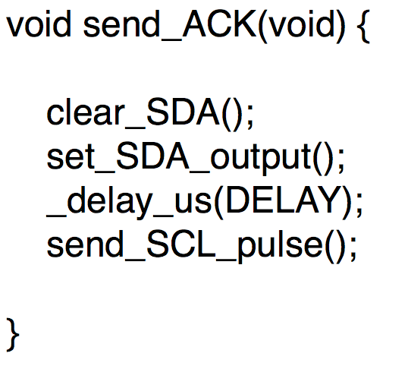
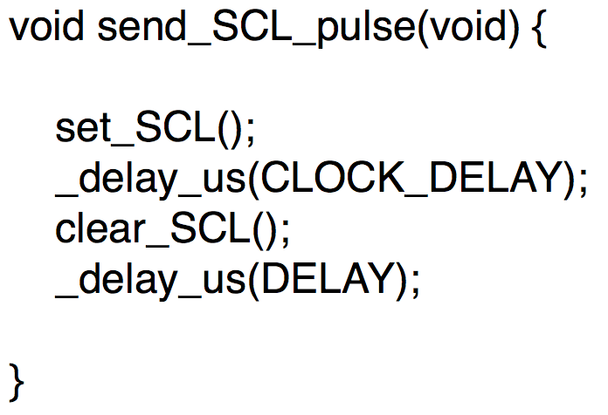
Code :
Notes:
All these functions are perfectly obvious from the signal specifications and data packet specifications

Slide 35
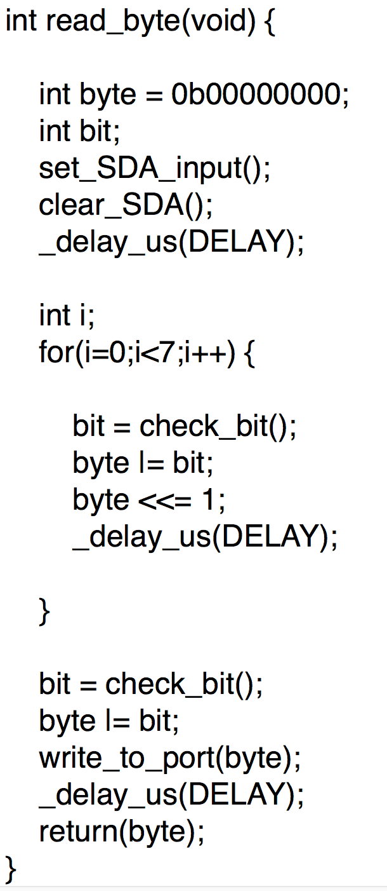
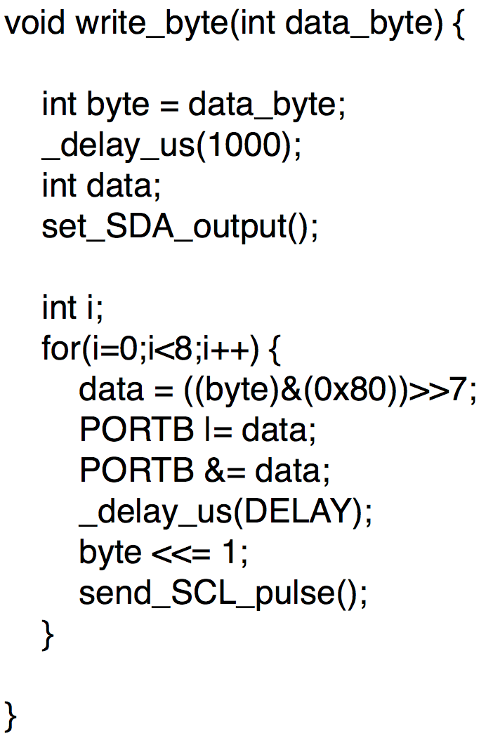
Code :
Notes:
Using these 7 functions, all I2C communications can be handled
as can been seen the MPU6050 example I’ll give you later

Slide 36
MPU6050
(by Invensense)

Slide 37
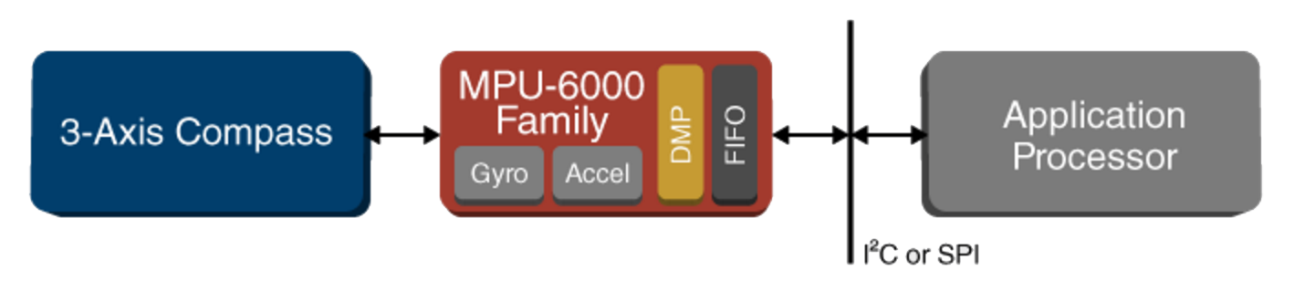
Consists of :
3 - axis Accelerometer
3 - axis Gyroscope
Temperature Sensor
Digital Motion Processor
FIFO buffers
Notes:
can interface with other sensors via I2C
DMP can be accessed only through Invensense’s firmware, …

Slide 38
Device Specification :
To write data to a register of MPU6050 :
Send MPU6050 Device ID on the I2C bus
write Register Address to the FIFO buffer
write Data to FIFO buffer
To read data from a register of MPU6050 :
Send MPU6050 Device ID on the I2C BUS
write Register Address to the FIFO buffer
read Data from the FIFO buffer
Notes:
next —> lets translate these steps to code

Slide 39
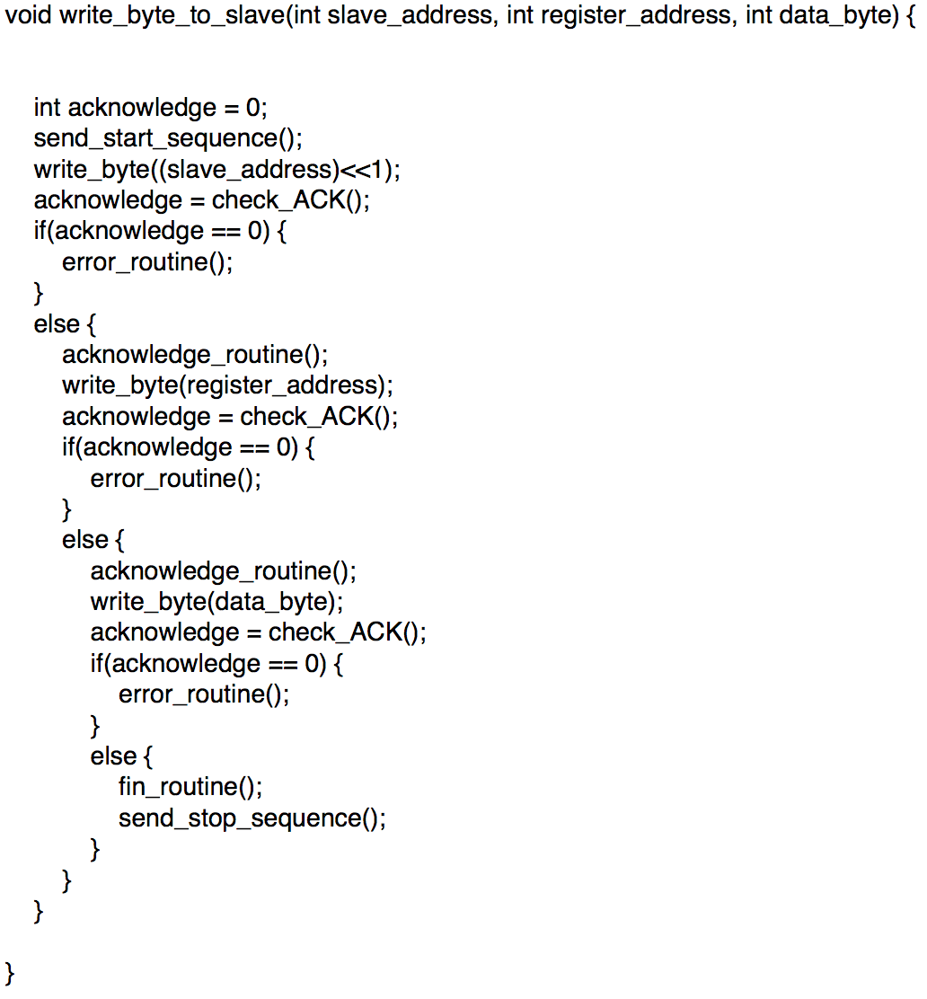
Code :
Notes:
these functions
error_routine()
acknowledge_routine()
fin_routine()
all blink different lights in different patterns, for me to debug my code

Slide 40
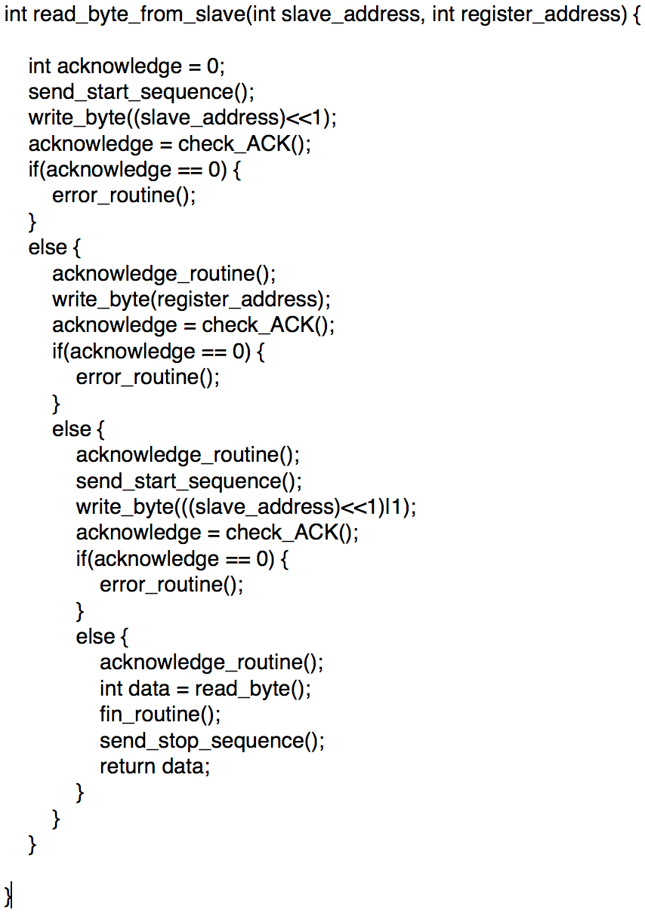
Code :
Notes:
with these two functions, we can do data acquisition from MPU6050, but there is just one more thing we need to know.
Which register of MPU6050 to read the data from?

Slide 41
MPU6050 Register Map :
There are 75 8-bit registers in the Register map
We only 15 of them

Slide 42
MPU6050 Register Map :
Power Management Register 1 (PWR_MGMT_1) :
the 6th bit of this register is the SLEEP bit, and it is 1 when MPU6050 is powered ON. The problem is that we need to clear it for MPU6050 to start working.
write_byte_to_slave(0x68,0x6B,0x00);

Slide 43
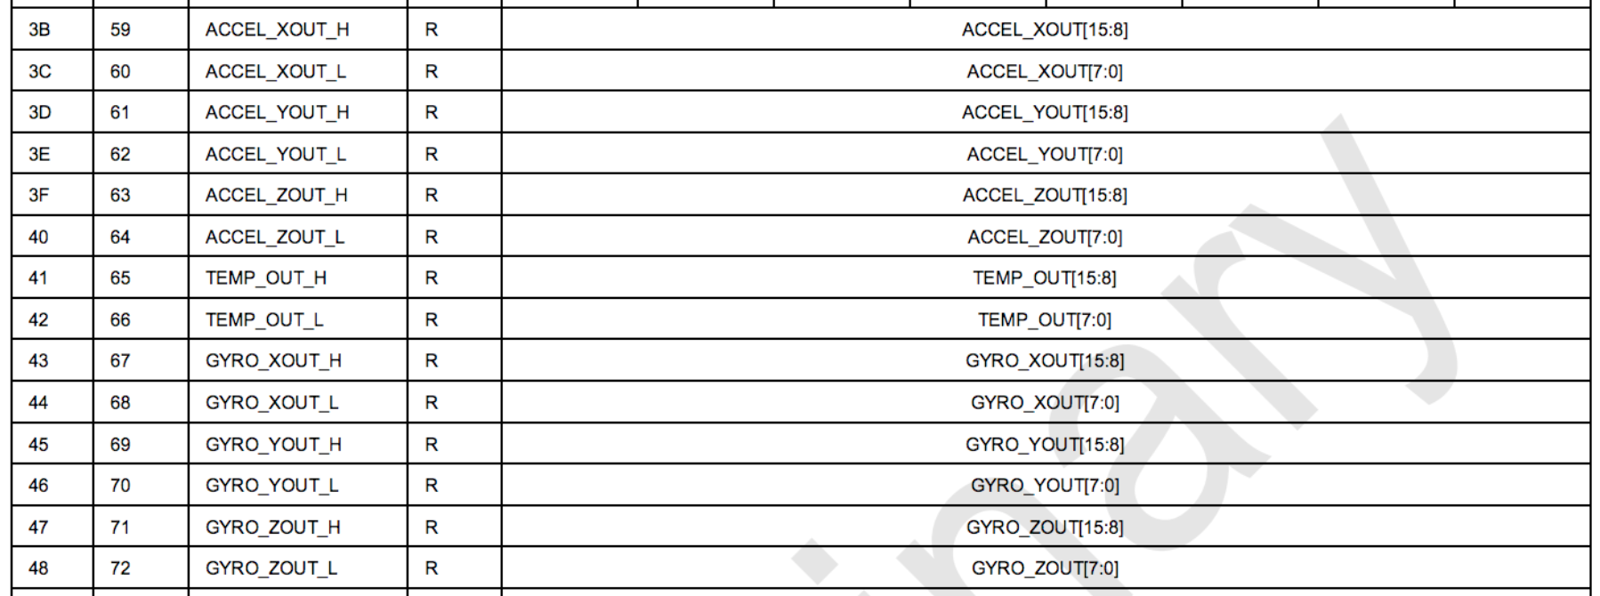
MPU6050 Register Map :
The values for each of the axes of accelerometer and gyroscope are stored as 16-bit data (two 8-bit registers combined).
Notes:
next —> Since I need to access all these values at once every time, I wrote the following function to do the same.

Slide 44
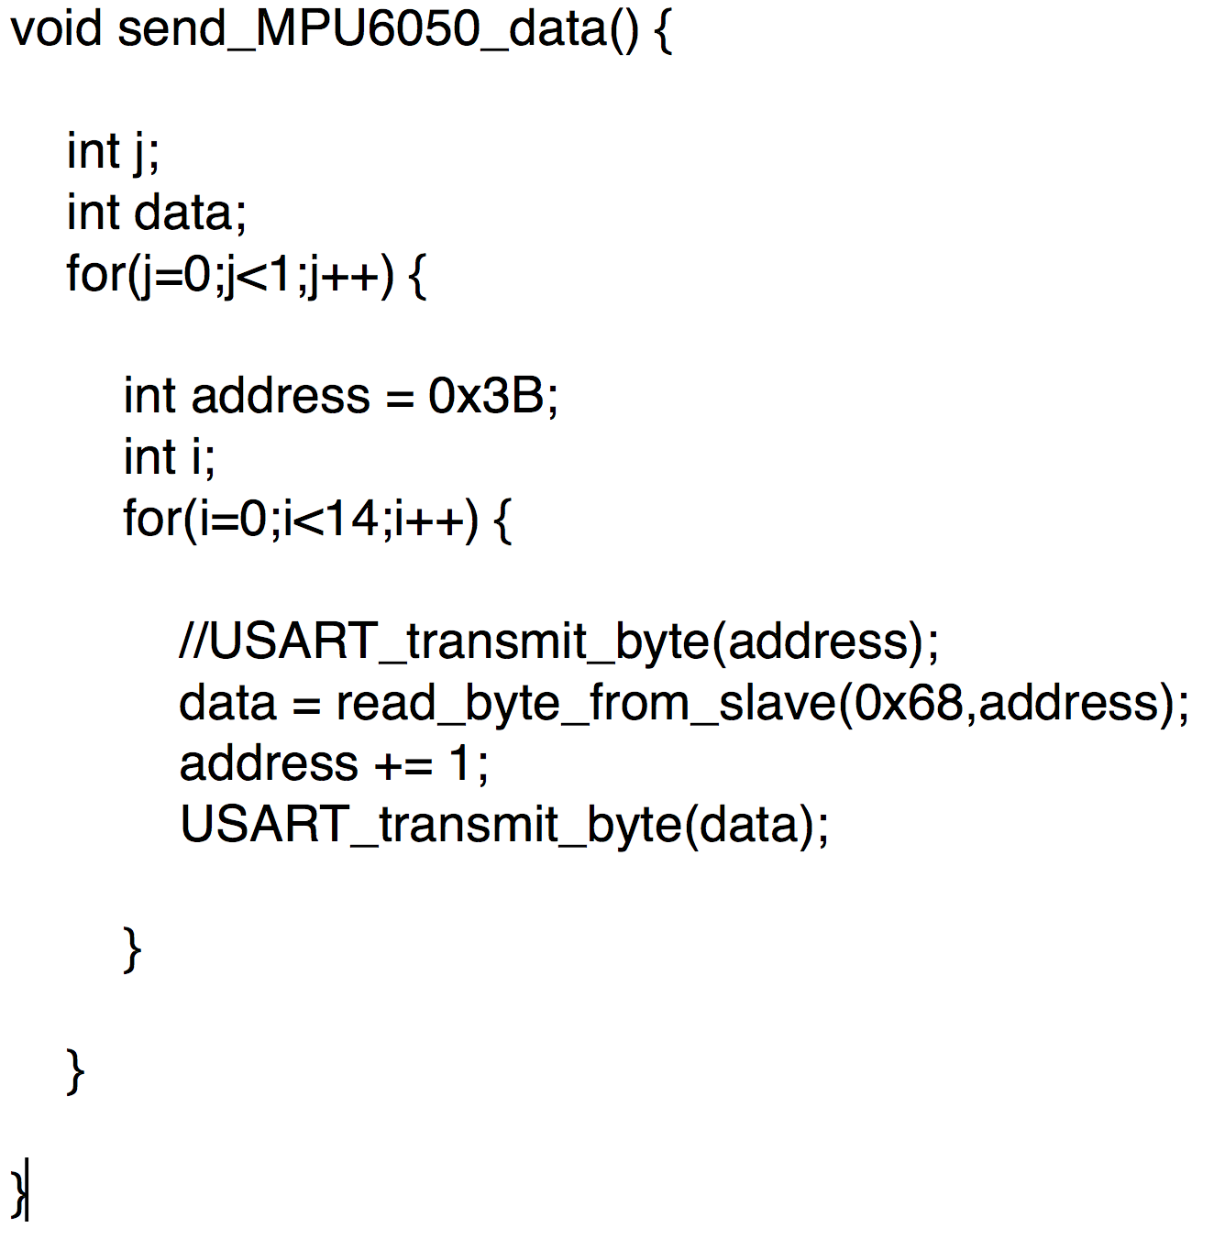
Code :
Notes:
everything should be obvious, except the USART_transmit_byte(data); statement …
There are two more registers that are important

Slide 45
MPU6050 Register Map :
gyroscope configuration register (GYRO_CONFIG)
accelerometer configuration register (ACCEL_CONFIG)
Notes:
these registers help in setting the full scale ranges of the accelerometer and gyroscope values
gyro values can range from + or - 250 degrees/sec to + or - 2000 degrees/sec
acc values can range from + or - 2g to + or - 16 g

Slide 46
Recap:
I2C Protocol
Basics
Circuit
Bus Connection
I/O Port Structure of ATmega microcontrollers
I2C Specifications
Signal Specifications
Data Packet Specifications
Device Specifications
MPU6050
Device Specifications
Register Map

Slide 47
Thank You

